Slide 1
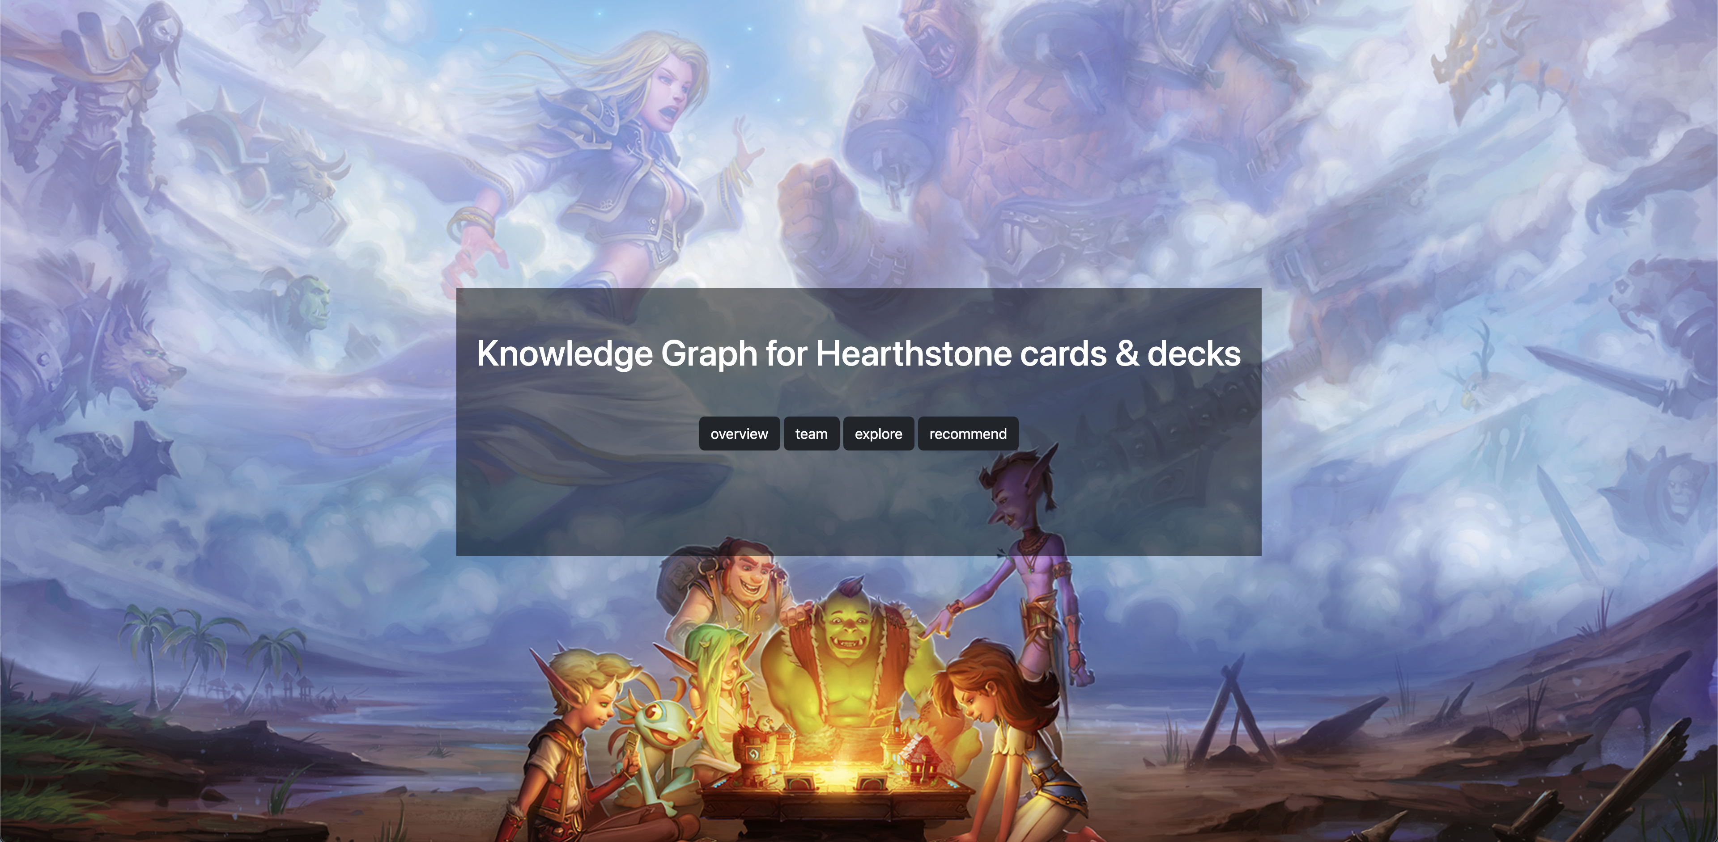
Building Knowledge Graph for Hearthstone cards & decks
Xuyang Wang, Yuqin Chen

Slide 2
Contents
Goal / Objective
Data Processing
Data Source
Data Extraction(Crawler)
Ontology
Asdasd
System Architechture

Slide 3
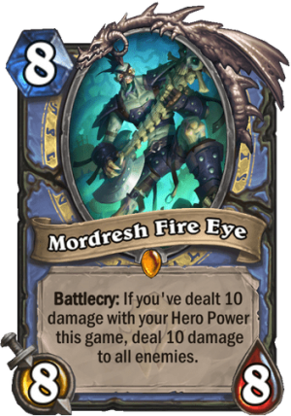
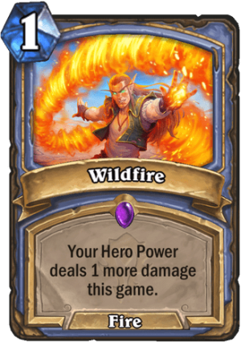
Goal / Objective
Building a knowledge graph about Hearthstone cards & decks - Players can explore relationship between cards & decks based on KG - Recommend related cards for player
SECRET MAGE
(a deck)
MORDRESH FIRE EYE
(a card)
Battlecry: If you've dealt 10 damage with your Hero Power this game, deal 10 damage to all enemis.
Mana Cost: 8
Attack: 8
Health: 8
Rarity: Legendary
Class: Mage
Type: Minion
Set: Forged in the Barrens
Mechanics: Battlecry, Damage All
…
MORDRESH FIRE EYE
(a card)
Battlecry: If you've dealt 10 damage with your Hero Power this game, deal 10 damage to all enemis.
Mana Cost: 8
Attack: 8
Health: 8
Rarity: Legendary
Class: Mage
Type: Minion
Set: Forged in the Barrens
Mechanics: Battlecry, Damage All
MORDRESH FIRE EYE
(a card)
Battlecry: If you've dealt 10 damage with your Hero Power this game, deal 10 damage to all enemis.
Mana Cost: 8
Attack: 8
Health: 8
Rarity: Legendary
Class: Mage
Type: Minion
Set: Forged in the Barrens
Mechanics: Battlecry, Damage All
MORDRESH FIRE EYE
(a card)
Battlecry: If you've dealt 10 damage with your Hero Power this game, deal 10 damage to all enemis.
Mana Cost: 8
Attack: 8
Health: 8
Rarity: Legendary
Class: Mage
Type: Minion
Set: Forged in the Barrens
Mechanics: Battlecry, Damage All
Wildfile
(a card)
Mana Cost: 1
Rarity: Epic
Class: Mage
Type: Spell
Set: Forged in the Barrens
Wildfile
(a card)
Mana Cost: 1
Rarity: Epic
Class: Mage
Type: Spell
Set: Forged in the Barrens
Wildfile
(a card)
Mana Cost: 1
Rarity: Epic
Class: Mage
Type: Spell
Set: Forged in the Barrens
Wildfile
(a card)
Mana Cost: 1
Rarity: Epic
Class: Mage
Type: Spell
Set: Forged in the Barrens
Wildfile
(a card)
Mana Cost: 1
Rarity: Epic
Class: Mage
Type: Spell
Set: Forged in the Barrens
Wildfile
(a card)
Mana Cost: 1
Rarity: Epic
Class: Mage
Type: Spell
Set: Forged in the Barrens

Slide 4
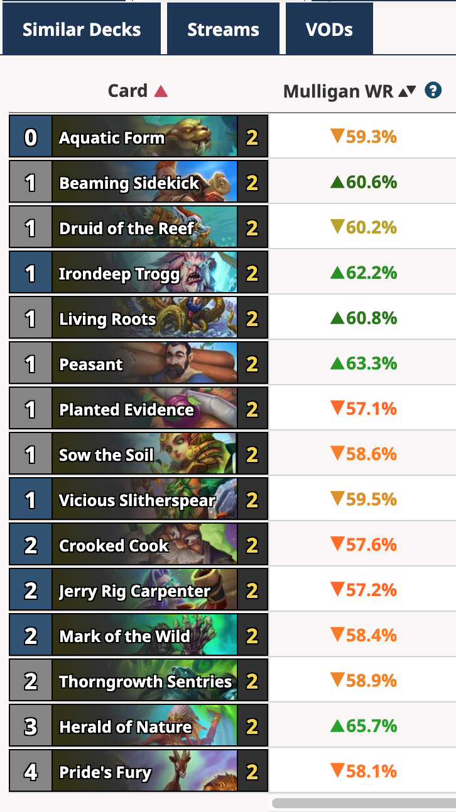
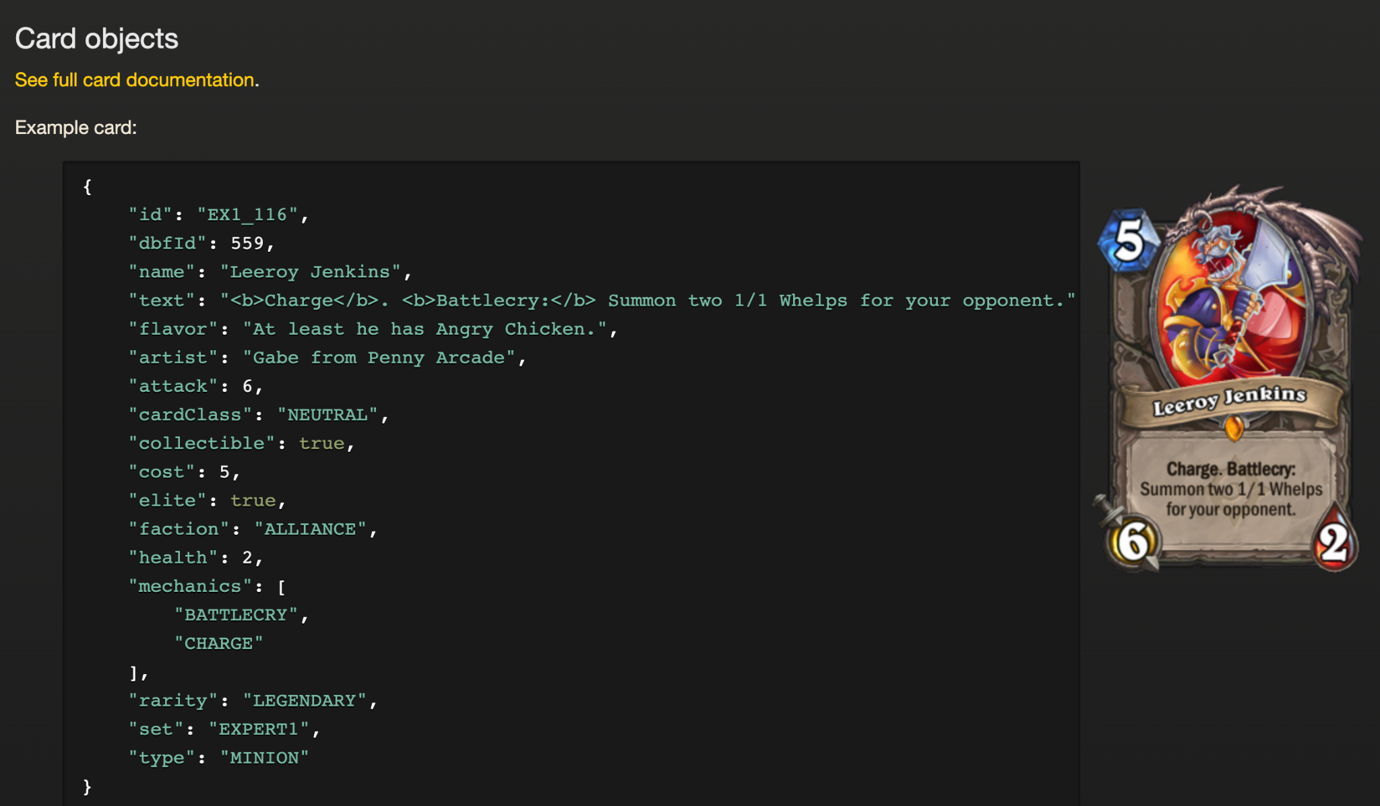
Data Source
Decks:
https://hsreplay.net/decks/ Decks: https://www.hearthstonetopdecks.com/
HearthstoneJSON
https://hearthstone.blizzard.com/en-us/cards

Slide 5
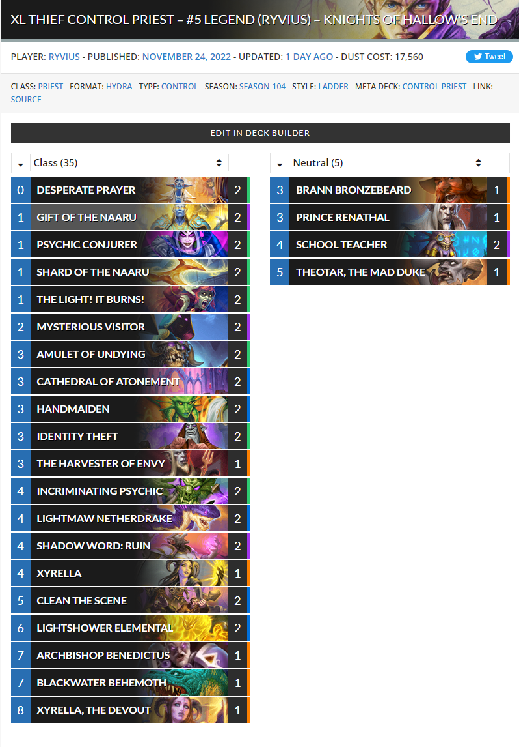
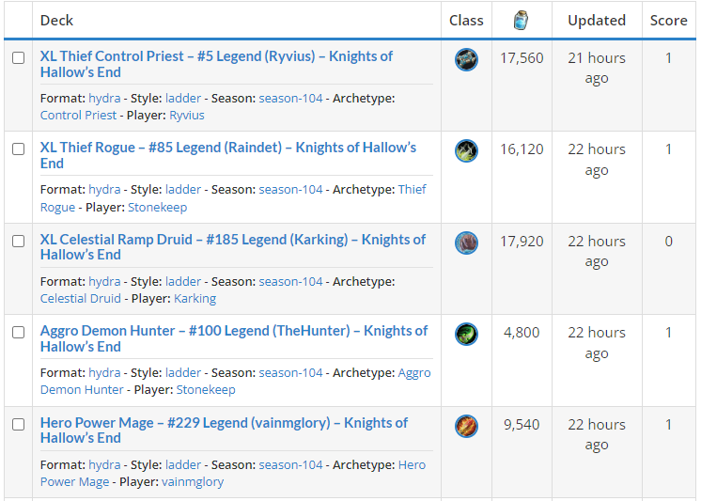
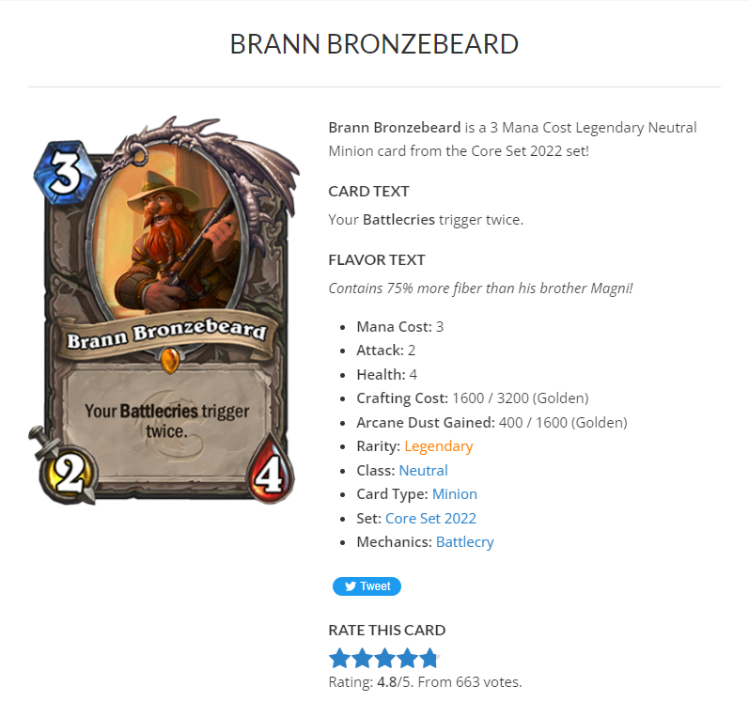
Data extraction -- How crawler works?
https://www.hearthstonetopdecks.com/decks/xl-thief-control-priest-5-legend-ryvius-knights-of-hallows-end/
https://www.hearthstonetopdecks.com/decks/
https://www.hearthstonetopdecks.com/cards/brann-bronzebeard/

Slide 6
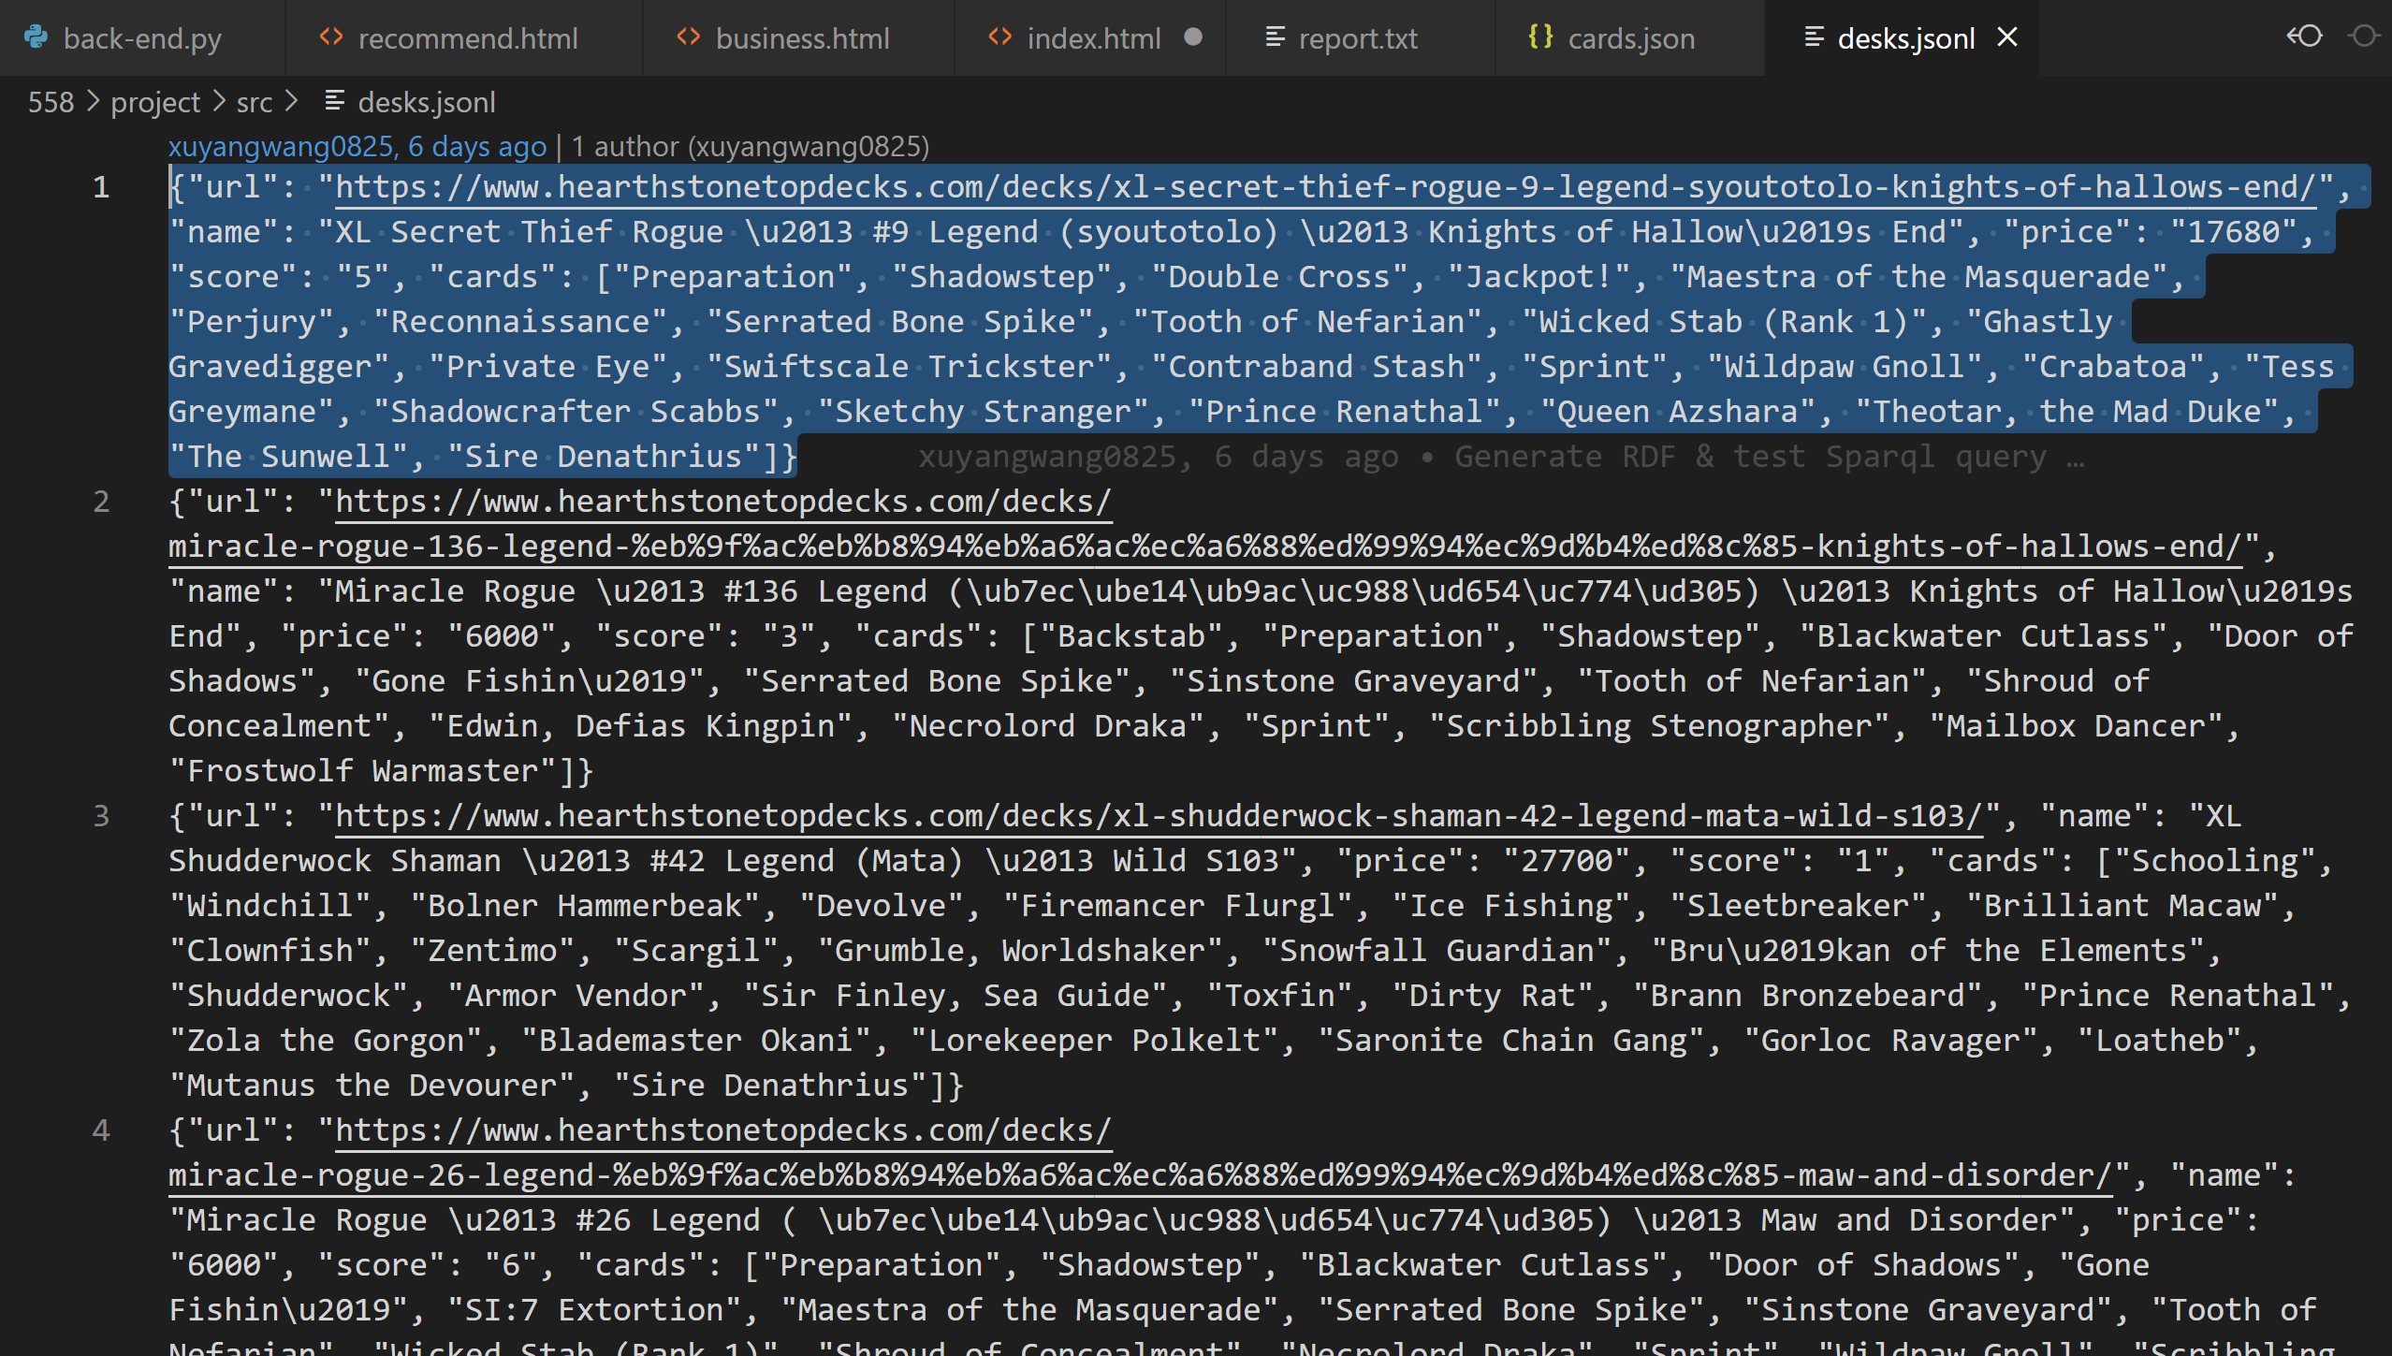
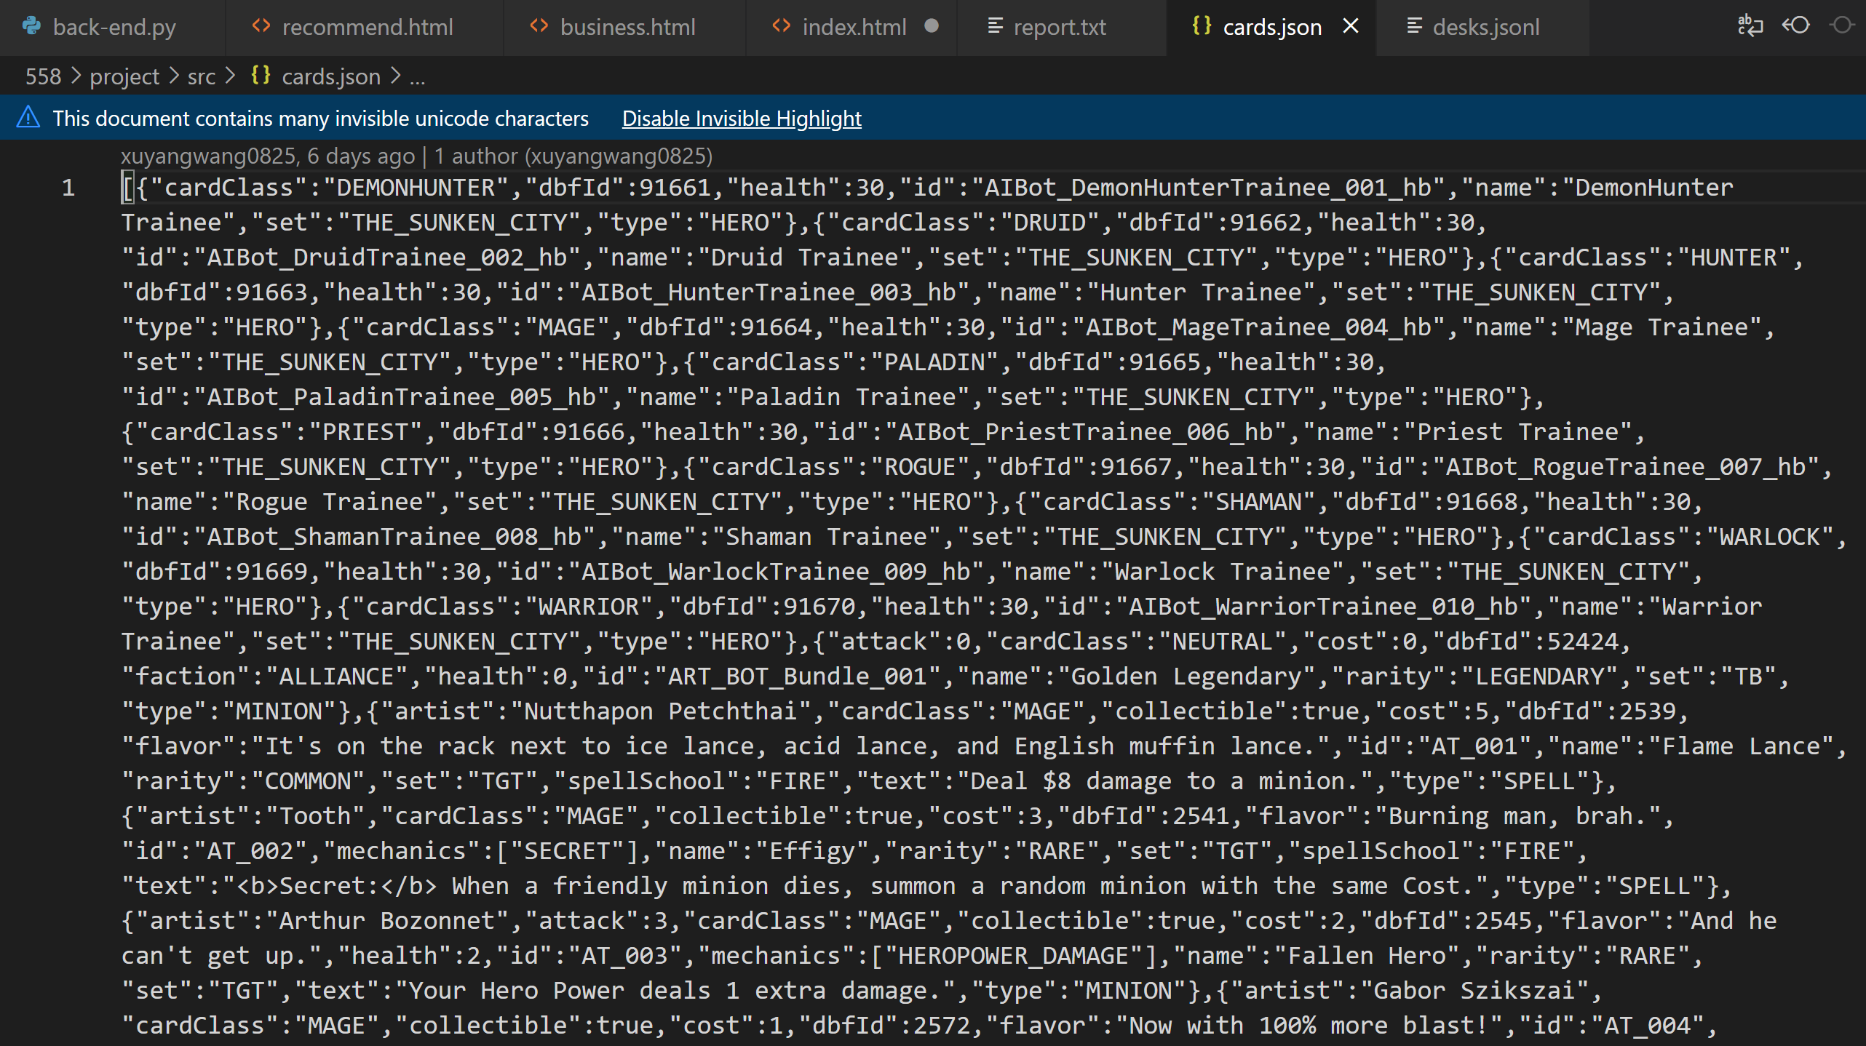
Data extraction -- How crawler store data? store data in two json files, then those files will be used for ontology build.

Slide 7
Data extraction -- Data volumn
each page contains about 20 desks
each desk contains about 20 cards
100 pages of newest desks shared by players
So, 100*20*20 = 40,000 !

Slide 8
Technical Challenge1: Big data volumn
Problem: How to get so many data without damaging the server or be banned by the server?
Solution: Set a delay between every two requests.
Evaluation:
- request one or two times per second is just like a normal human action, so not damage the server;
- succesfully got all data without any restriction or ban by the website after the program ran several hours.

Slide 9
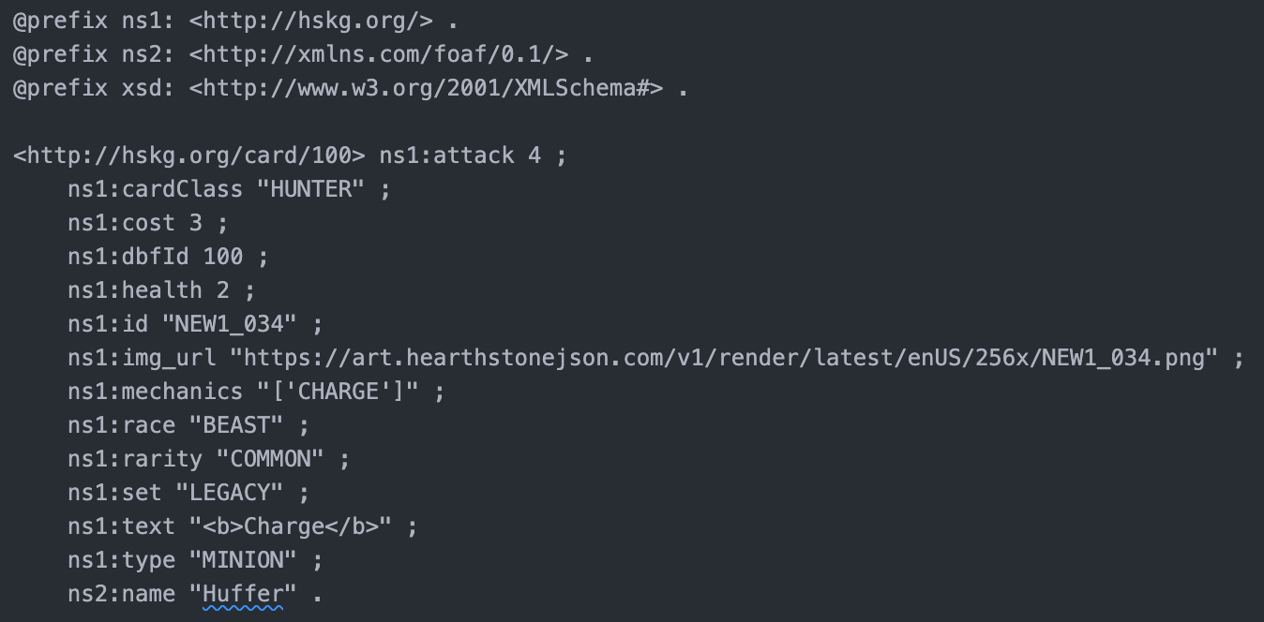
Ontology
Card:

Slide 10
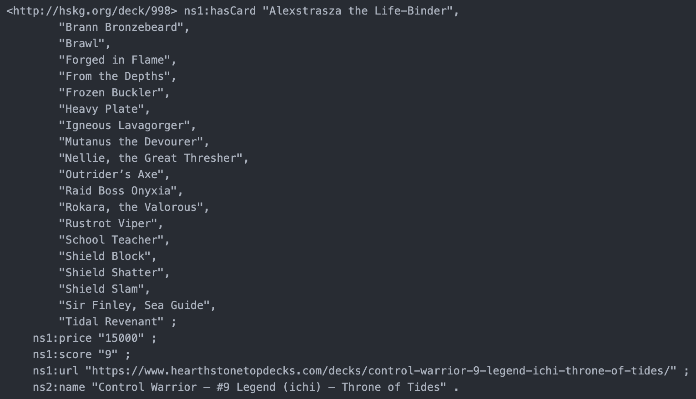
Ontology
Deck:

Slide 11







System Architechture
Card & Deck KG
Embedding and training
Recommend cards
Unstructured Data

Slide 12
Technical Challenge2: Explore Card & Deck
Problem: How to give player a easy way to explore the card they want? Example: A player want to find a replacement of a card in mage class and cost 7+.
Solution:
- Build KG for cards
- Use sparql to search and filter the entitys
- Return result as a graph to help player find the card they want.
Evaluation:
- That’s very precise. Player can modify the parameter of filter to get the result space as a graph.

Slide 13
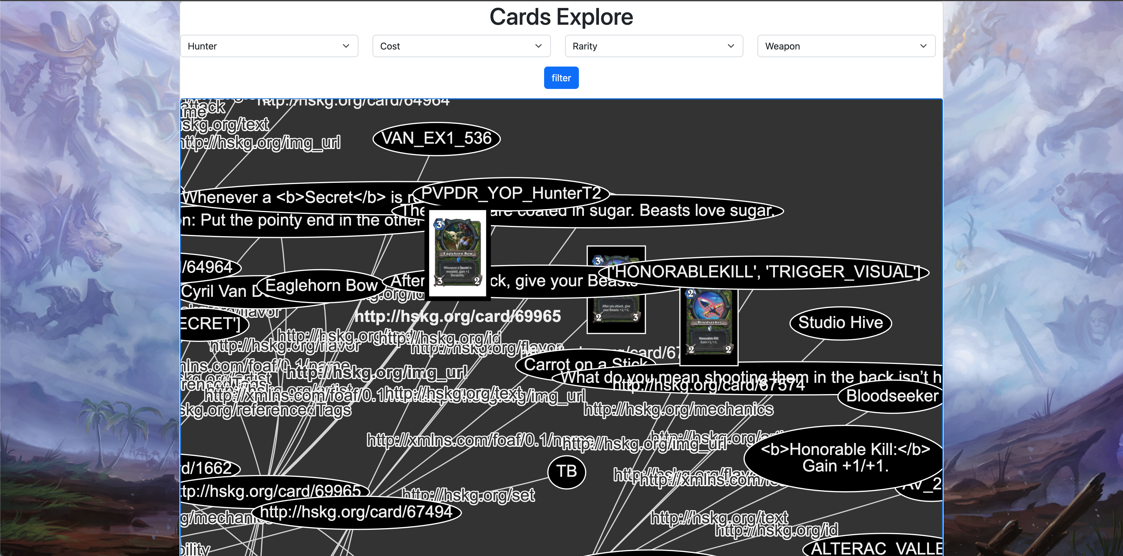
Explore Card
Parameters:
Class : [Mage, Hunter…] 12classes
Cost: [0～6, 7+]
Rarity: [Free, Common, Rare, Epic, Legendary]
Type: [Minion, Weapon, Spell…] 7 types

Slide 14
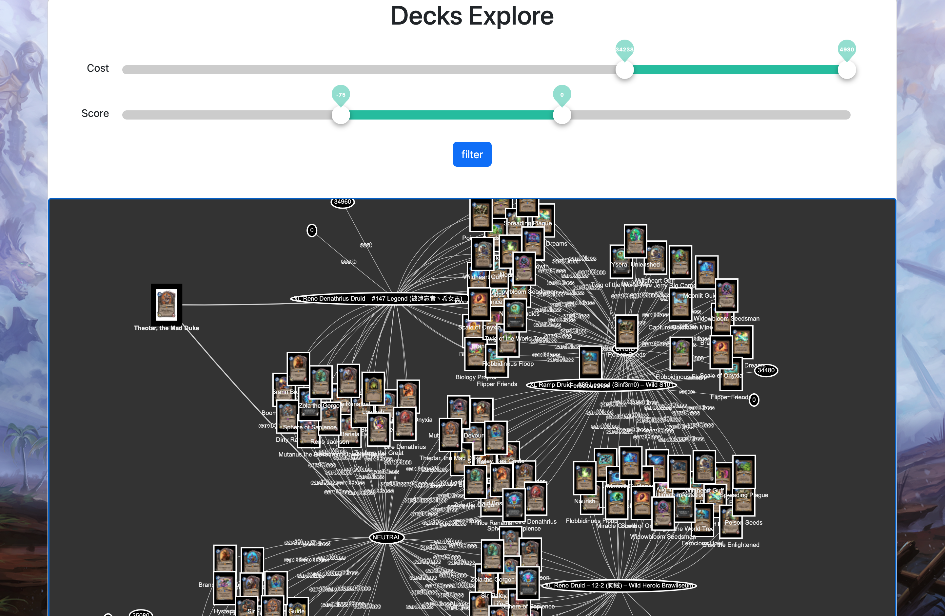
Explore Deck
Parameters:
Score: [-150, 150]
Cost: [0~50000] Arcane Dust

Slide 15
Technical Challenge3: Recommender System
Problem: How to recommend more cards for a existing desk?
Solution: Build a TransE model. (More details in report)
Evaluation: Randomly hide 20% data in the triples (desk-hasCard->card) as test dataset, got a 0.09 MRR.

Slide 16
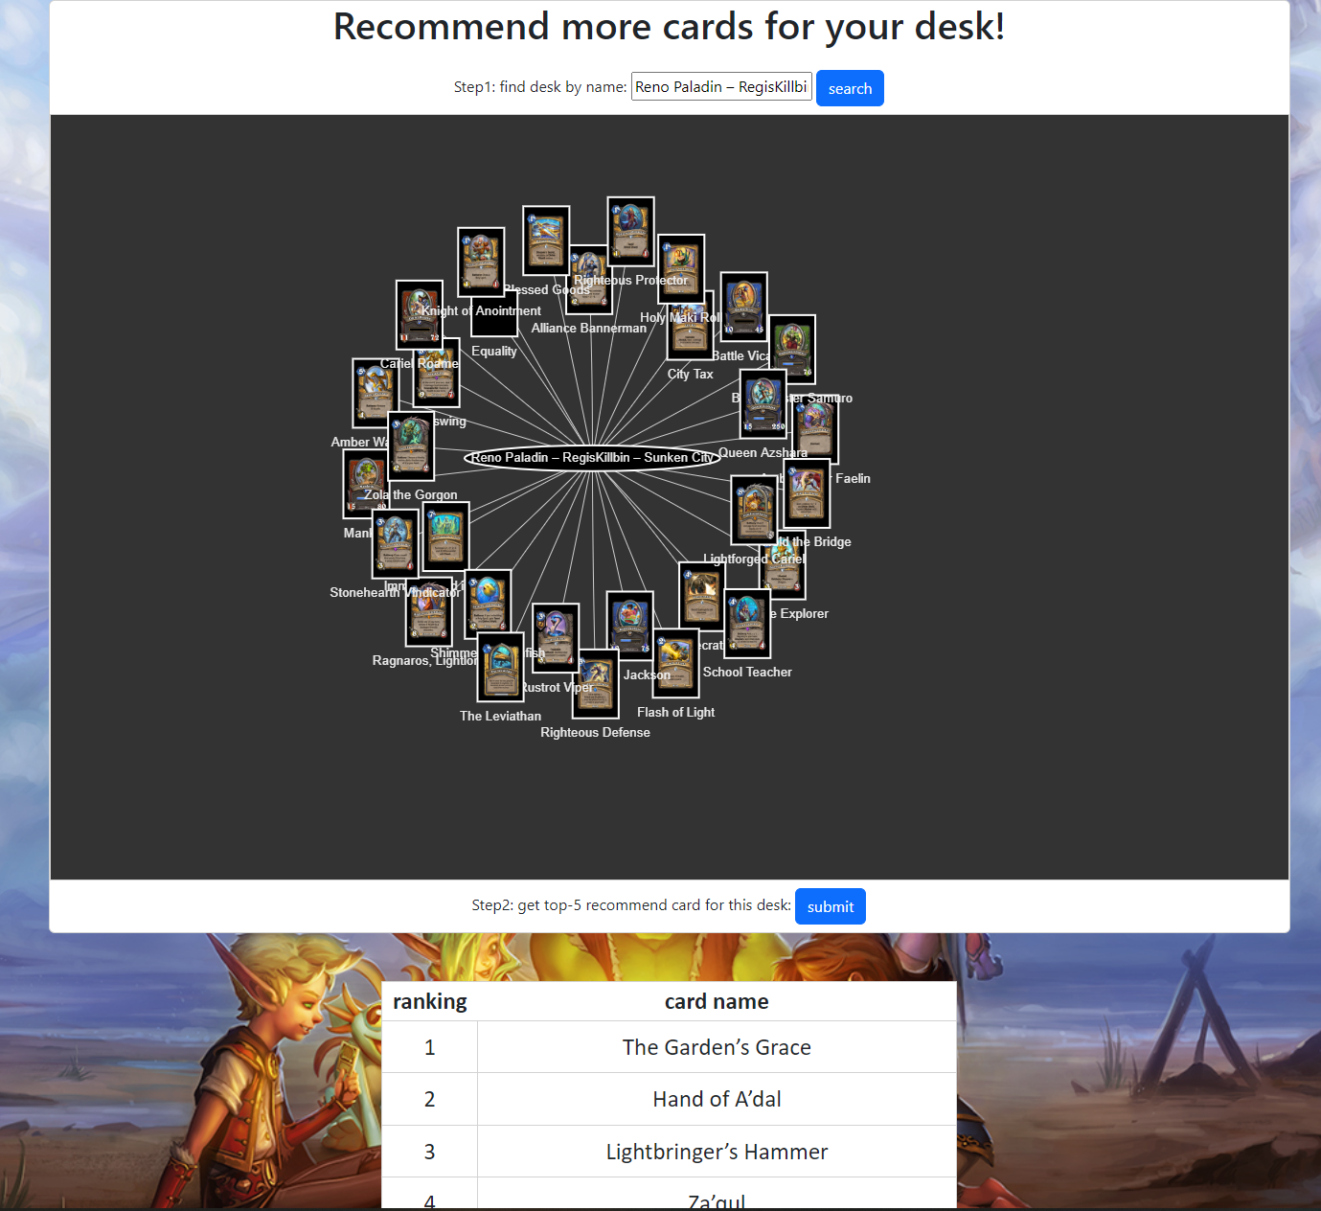
Recommend card for a desk

Slide 17
KG Quality

